Slide 1
ARTIFICIAL INTELLIGENCE
PHASE-V

Slide 2
DOCUMENTATION - PART
PRESENTED BY
TEAM LEADER : KAVIBHARATHI G
TEAM MEMBERS : RAVIKUMAR M
BOOPATHI C
DHAYALAN R
BHUVANESWARAN M

Slide 3
PROJECT
PROGRAM:
import nltk
from nltk.chat.util import Chat, reflections
reflections = {
"i am" : "you are",
"i was" : "you were",
"i" : "you",
"i'm" : "you are",
"i'd" : "you would",
"i've" : "you have",
"i'll" : "you will",
"my" : "your",
"you are" : "I am",
"you were" : "I was",
"you've" : "I have",
"you'll" : "I will",
"your" : "my",
"yours" : "mine",
"you" : "me",
"me" : "you"
}

Slide 4
pairs=[
["hi",["Hi!,I'm chatbot, how can i help you?"]],
["need help",["how can i help you?"]],
["tourist place in India",["1.Tamilnadu 2.Delhi 3.kerala 4.karanataka 5.Mumbai"]],
["Delhi",["1. Qutub Minar · 2. Swaminarayan Akshardham · 3. Humayun's Tomb · 4. Gurudwara Bangla Sahib · 5. Lodhi Garden · 6. India Gate. 7.Tajmahal "]],
["Kerala",[" 1.Munnar · 2.Thekkady · 3.Kovalam · 4.Bekal · 5.Kozhikode · 6.Alleppey · 7.Vagamon · 8.Trivandrum."]],
["Thekkady",["Pullumedu, Murikkady, Kadathanadan Kalari Center, Periyar National Park, Vandanmedu, Elephant Junction"]],
["Alleppey",["1. Mannarasala Sree Nagaraja Temple · 2. Alleppey Backwaters · 3. Ambalapuzha Sree Krishna Temple · 4. Kathakali · 5. Sree Subramanya"]],
["Bekal",["1. Bekal Beach · 2. Bekal Fort · 3. Kappil Beach · 4. Valiyaparamba Backwaters · 5. Nityanandashram Caves · 6. Chandragiri Fort"]],
["Vagamon ",["1. Vagamon Pine Forest · 2. The Pattumalai Church · 3. Vagamon Kurisumala · 4. Barren Hills · 5. Thangal Hill · 6. Vagamon Falls."]],
["Gurudwara Bangla Sahib",["1. Jantar Mantar ; 2. Connaught Place ; 3. Birla Temple ; 4. Rashtrapati Bhawan ; 5. India Gate."]],
["Lodhi Garden",["1. Tomb of Muhammad Shah · 2. Bada Gumbad · 3. Sheesh Gumbad · 4. Tomb of Sikander Lodhi"]],
["Yercaud",["1. Peeku Park Yercaud · 2. 32-km Loop Road · 3. Pagoda Point · 4. Big Lake · 5. Shevaroy Temple "]],
["Madurai",["1. Madurai Meenakshi Amman Temple · 2. Alagarkoil Temple and Shrine · 3. Gandhi Memorial Museum · 4. Aayiram Kaal Mandapam · "]],
["Yelagiri",["1. Cloud Forest Entertainment Park · 2. Fundera Park · 3. Swamimalai Hills · 4. Velavan Temple · 5. Nilavoor Lake ·"]],
["Tamilnadu",["1.Ooty, 2.Kodaikanal, 3.Yercaud, 4.Yelagiri, 5.Madurai, 6.Rameshwaram, 7.Kanyakumari, 8.Thanjavur, 9.Kanchipurm."]],
["need help",["how can i help you?"]],
["need help",["how can i help you?"]],
["karnataka",["1. Bangalore · 2. Coorg · 3. Hampi – One of the recommended places to visit in Karnataka · 4. Badami, Aihole and Pattadakal · 5. Kabini · 6. Jog Falls · 7. Mangalore."]],
["Bangalore",["1. Bannerghatta National Park · 2. Chunchi Falls · 3. Ulsoor Lake · 4. Bangalore Aquarium."]],

Slide 5
["Mangalore",[" 1. Panambur Beach · 2. Kudroli Temple · 3. St Aloysius Chapel · 4. Kadri Manjunath Temple. Kadri Manjunath Temple."]],
["Jog Falls",["1. Linganamakki Dam · 2. Dabbe Falls · 3. Tunga Anicut Dam · 4. Kanoor Fort · 5. Water Sports at Honnemradu · "]],
["Kabini",["1. Jungle Safari, Kabini · 2. Boating in Kabini · 3. Nagarhole National Park · 4. Kabini Dam."]],
["munnar",["1. Tea Gardens · 2. Kalari Kshethra · 3. Top Station · 4. Munnar Hiking Trails · 5. Rajamalai (Eravikulam) National Park · 6. Kundala Dam ."]],
["Qutub Minar",["1. Jagannath Temple · 2. Iron Pillar of Delhi · 3. Jamali Kamali Tomb and Mosque · 4. Iltutmish's Tomb · 5. Alai Minar."]],
["Ooty",["1. Avalanche Lake · 2. Ooty Lake · 3. Emerald Lake · 4. Ooty Botanical Gardens · 5. Deer Park"]],
["Coorg",["1. Mercara Gold Estate Coffee Plantation & Museum · 2. Mandalpatti Peak · 3. Abbey Falls · 4. Raja's Seat · 5. Dubare Elephant "]],
["Swaminarayan Akshardham",["1. Exhibitions · 2. Sahajanand Darshan - The Hall of Values · 3. Neelkanth Darshan - · 4. Sanskruti Darshan - Cultural Boat Ride · 5. Musical Fountain "]],
["Humayun's Tomb",["1. Tomb and mosque of Isa Khan: · 2. Bu Halima's tomb and garden: · 3. Afsarwala tomb and mosque: · 4. Arab Sarai: · 5. Nila Gumbad:"]],
["Kozhikode",["1. Kappad Beach · 2. Kozhikode Beach · 3. Tali Temple · 4. Kariyathumpara · 5. Sargaalaya · 6. Beypore Beach · 7. S.M. Street"]],
["Kovalam",["1. The Three Crescent Beaches · 2. Samudra Beach · 3. Vizhinjam Village · 4. Chowara · 5. Valiyathura Pier · 6. Thiruvallam · 7. Vellayani"]],
["Kodaikanal", ["1. Coakers Walk · 2. Kodaikanal Lake · 3. Berijam Lake · 4. Poombarai Village View · 5. Mannavanur Lake · 6. Pillar Rocks · 7. Pine "]],
["Rameshwaram",["1. Arulmigu Ramanatha Swamy Temple · 2. Dhanushkodi Beach Point · 3. Pamban bridge · 4. Dr. A.P.J. Abdul Kalam Memorial · 5. Annai Indira Gandhi Road Bridge"]],

Slide 6
["what kind?",["i like to listen to rock and r&b."]],
["where are you going?",["i have to walk the dog."]],
["what kind of dog do you have?",["i have a little poodle.poodles bark a lot.they sure do.they sure do.they bark at everything.they never shut up."]],
["why did you get a poodle?",[" it's my mom's dog.so she likes poodles. she says they're good watchdogs."]],
["can i borrow $5?",["sure."]],
["why do you need it?",["i want to buy lunch."]],
["where's your money?",["it's not in my wallet."]],
["your wallet is empty?",["i don't have even one dollar in it.being broke is no fun.even if it's only for a short while.friends will lend you money when you're broke. as long as you pay them back. let's go to the beach.that's a great idea."]],
["what's on tv?",["nothing.there must be something on tv!nothing that's interesting."]], ["what about that new game show?which one?",["deal or no deal tell me you're joking.i watched it once. that was enough.it's on right now. let's watch it together."]],
["That’s marvelous. Could you please guide me there?",["Yeah sure."]],]

Slide 7
print("Hi! I am a chatbot created by JKKM COLLEGE OF TECHNOLOGY")
print("Welcome to the Virtual Travel Guide Chatbot!")
while True:
chatbot = Chat(pairs, reflections)
pairs = input("YOU:")
if pairs.lower() == 'quit':
break
reflections = chatbot.respond(pairs)
print(f"BOT:{ reflections}")
chatbot.converse()

Slide 8
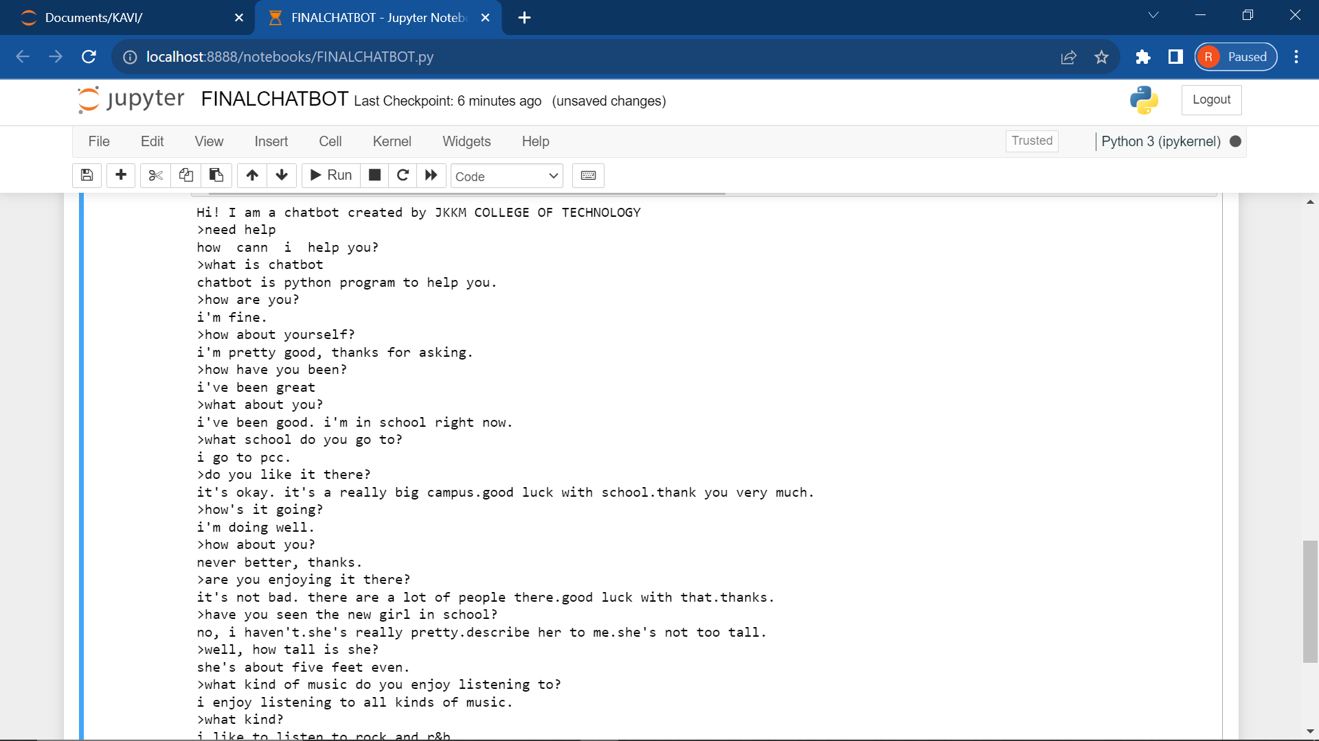
OUTPUT

Slide 9
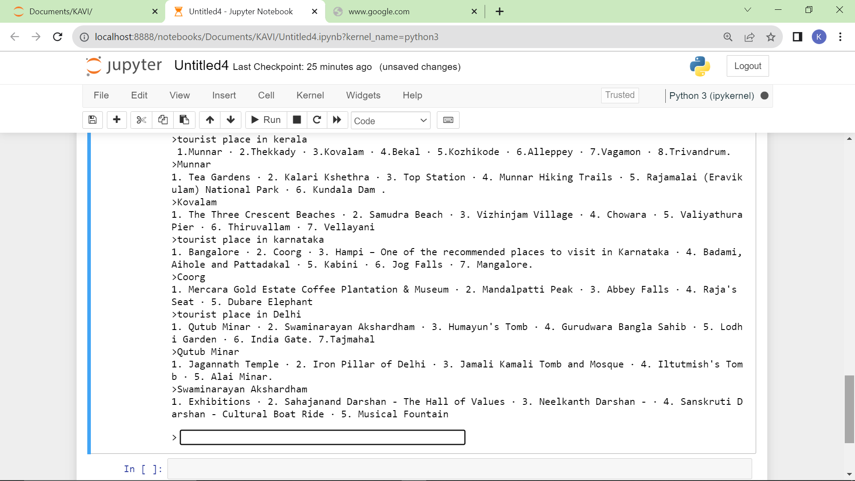

Slide 10
Problem Statement
Challenge:
People often struggle to plan their trips efficiently, gather relevant information, and make the most of their travel experiences.
Objective:
Create a virtual travel guide chat bot that assists users in planning their trips, provides real-time information, and enhances their overall travel experience.

Slide 11
Design Thinking Process
Empathize:
Understand the pain points of travelers.
Conduct user surveys and interviews to identify common issues.
Define:
Clearly articulate the problems users face in trip planning.
Prioritize the most critical pain points to address.

Slide 12
Ideate:
Brainstorm features and functionalities that can address identified issues.
Encourage creative thinking to come up with innovative solutions.
Prototype:
Develop a basic version of the chatbot with essential features.
Use wireframes and mockups to visualize the user interface.
Test:
Gather feedback from potential users.
Iteratively improve the prototype based on user input

Slide 13
Phases of Development
Phase 1: Planning and Research
Define the scope and objectives of the chatbot.
Research APIs for real-time data (weather, local events, etc.).
Identify key destinations and travel preferences.
Phase 2: Design and Prototyping
Create wireframes and design the user interface.
Develop a prototype with basic functionalities (e.g., destination suggestions, weather information).

Slide 14
Phase 3: Development
Build the backend infrastructure for data retrieval and storage.
Implement natural language processing (NLP) for better user interactions.
Develop the frontend to ensure a seamless user experience.
Phase 4: Testing and Refinement
Conduct extensive testing to identify and fix bugs.
Test the chatbot with a diverse group of users to ensure inclusivity.
Refine the user interface and user experience based on feedback.

Slide 15
Phase 5: Deployment
Deploy the chatbot on selected platforms (web, mobile apps, messaging apps).
Monitor its performance and gather real-time user data.
Phase 6: Continuous Improvement
Collect user feedback post-launch and implement necessary updates.
Regularly update destination information, add new features, and enhance existing ones.

Slide 16
Virtual Travel Guide Chatbot Dataset
The dataset for a virtual travel guide chatbot needs to cover a range of information related to destinations, activities, accommodations, events, and more.
User Preferences:
Historical user interactions.
User reviews and ratings for destinations.

Slide 17
Destination Information:
Location details (latitude, longitude).
Popular attractions and landmarks.
Local cuisine and dining options.
Historical and cultural information.
Real-time Data:
Weather conditions.
Local events and festivals.
Traffic updates.

Slide 18
Data Preprocessing Steps
Data preprocessing is crucial for cleaning and formatting the data for effective use.
Handling Missing Data:
Identify and handle missing values in the dataset.
Text Cleaning:
Remove special characters, punctuation, and unnecessary whitespace.
Convert text to lowercase for consistency.

Slide 19
Data Normalization:
Normalize numerical values to a standard scale.
Tokenization:
Break down sentences into individual words or tokens.
Lemmatization and Stemming:
Reduce words to their base or root form to enhance text analysis.
Entity Recognition:
Identify entities (locations, activities) within the text for better context understanding.

Slide 20
Feature Extraction Techniques
Feature extraction involves transforming raw data into a format suitable for machine learning models.
Bag of Words (BoW):
Representing text data as a bag of words for natural language processing.
TF-IDF (Term Frequency-Inverse Document Frequency):
Assigning weights to words based on their importance in a document.

Slide 21
Word Embeddings:
Using pre-trained word embeddings (Word2Vec, GloVe) to capture semantic relationships between words.
Geospatial Features:
Extracting features from latitude and longitude data to understand geographical relationships.
Temporal Features:
Incorporating time-related features for events, weather conditions, etc.

Slide 22
User Interaction History:
Utilizing historical user interactions to personalize recommendations.
Dataset Integration:
Integrate the preprocessed and feature-extracted data into a unified dataset that the chatbot can leverage for providing relevant and personalized information.
Continuous Updating:
Regularly update the dataset to ensure that the chatbot has access to the latest information.
This may involve periodic retraining of machine learning models and updating real-time data sources.

Slide 23
Machine Learning Algorithm
The virtual travel guide chatbot can utilize a supervised learning approach, where the model learns from historical user interactions to make predictions or recommendations.
A suitable algorithm for this task could be a recommendation system or a natural language processing (NLP) model.

Slide 24
Recommendation System:
Collaborative Filtering: Recommends destinations or activities based on user preferences and behavior similar to other users.
Content-Based Filtering: Recommends items based on their features and the user's preferences.
Intent Recognition: Understands the user's intent and queries to provide relevant responses.
Named Entity Recognition (NER): Identifies entities such as locations, activities, and events in user input.

Slide 25
Model Training
Data Splitting:
Divide the dataset into training and testing sets to assess the model's performance accurately.
Feature Representation:
Utilize the preprocessed and feature-extracted data for training.
Convert textual information into numerical vectors using techniques like TF-IDF or word embeddings.

Slide 26
Model Selection:
Choose a machine learning model based on the specific requirements.
For recommendation systems, collaborative filtering algorithms (e.g., Matrix Factorization) or content-based models could be employed.
For NLP tasks, models like recurrent neural networks (RNNs) or transformer-based models (e.g., BERT) might be suitable.
Training:
Train the selected model on the training dataset, adjusting weights and parameters to minimize error or loss.

Slide 27
Evaluation Metrics
The performance of the virtual travel guide chat bot needs to be assessed using appropriate metrics.
For Recommendation System:
Precision and Recall:
Precision measures the accuracy of the recommended items.
Recall assesses the system's ability to recommend all relevant items.
Mean Average Precision (MAP):
Calculates the average precision across multiple users.

Slide 28
Root Mean Squared Error (RMSE):
Measures the difference between predicted and actual ratings.
For NLP Models:
Accuracy:
Measures the overall correctness of the model's predictions.
F1 Score:
Balances precision and recall, especially important for imbalanced classes.
Intent Recognition Accuracy:

Slide 29
Specific to NLP models, it measures the accuracy of identifying user intents.
Continuous Improvement:
Regularly update the model based on new data, user interactions, and feedback to enhance its performance and accuracy.
This iterative process ensures that the virtual travel guide chatbot becomes more adept at providing personalized and relevant recommendations over time.

Slide 30
Innovative Techniques
Reinforcement Learning for Personalization:
Implement reinforcement learning to allow the chatbot to learn and adapt its recommendations based on user feedback over time.
This can enhance personalization and improve user satisfaction.
Graph-Based Recommendation System:
Use a graph-based recommendation system to model relationships between users, destinations, and activities.
This approach can capture intricate connections and offer more nuanced recommendations.

Slide 31
Transfer Learning for NLP:
Leverage transfer learning in NLP models, utilizing pre-trained language models (e.g., BERT or GPT) to understand user queries more effectively.
Fine-tuning these models on travel-specific data can enhance their contextual understanding.
Interactive Conversational Agents:
Incorporate interactive and dynamic conversations into the chatbot, allowing users to engage in more natural and fluid interactions.
This involves considering context across multiple user queries and responses.

Slide 32
Augmented Reality (AR) Integration:
Integrate AR features to provide users with immersive experiences.
For example, users could receive AR-guided directions, information overlays on landmarks, or virtual previews of destinations.
Sentiment Analysis for Real-Time User Feedback:
Implement sentiment analysis on user reviews and feedback to gauge the emotional tone of experiences at different destinations.
This information can be valuable for recommending places that align with the user's preferences.

Slide 33
Multi-Modal Inputs:
Support multi-modal inputs, such as images or voice commands, to enhance user interactions.
Users could, for instance, upload pictures of places they like, and the chatbot can recommend similar destinations.
Explainable AI (XAI) for Transparency:
Incorporate explainable AI techniques to make the chatbot's recommendations more transparent.
Users can understand why certain suggestions are made, fostering trust and user confidence.

Slide 34
Dynamic Pricing and Availability Information:
Integrate real-time pricing and availability information for accommodations, flights, and activities.
This dynamic information ensures that users receive the most up-to-date and accurate details for their travel plans.
Collaborative Planning Features:
Enable collaborative trip planning, allowing multiple users to contribute to and modify travel itineraries in real time.
This social aspect enhances the chatbot's utility for group travel.

Slide 35
Behavioral Analysis for Continuous Learning:
Implement behavioral analysis to understand how user preferences evolve over time.
This continuous learning approach ensures that the chatbot adapts to changing user interests and trends.
Gamification Elements:
Introduce gamification elements into the chatbot, turning trip planning into an engaging and enjoyable experience.
Users could earn rewards for exploring new destinations or completing certain travel challenges.

Slide 36
THANKING YOU
Mentor Evaluator SPOC HOD

